Slide 1


Slide 2


Devnet Module 4
Understanding and Using APIs

Slide 3

Module Objectives
Topic Title | Objectives
Introducing APIs | Explain the use of APIs.
API Design Styles | Compare synchronous and asynchronous API design styles.
API Architecture Styles | Describe common API architecture styles.
Introduction to REST APIs | Explain the functions of REST APIs.
Authenticating a REST API | Create REST API requests over HTTPS to securely integrate services.
API Rate Limits | Explain the purpose of API rate limits
Working with Webhooks | Explain the use of webhooks.
Troubleshooting API Calls | Explain how to troubleshoot REST APIs
Use REST API over HTTPS to facilitate service integration.

Slide 4

Introducing APIs

Slide 5

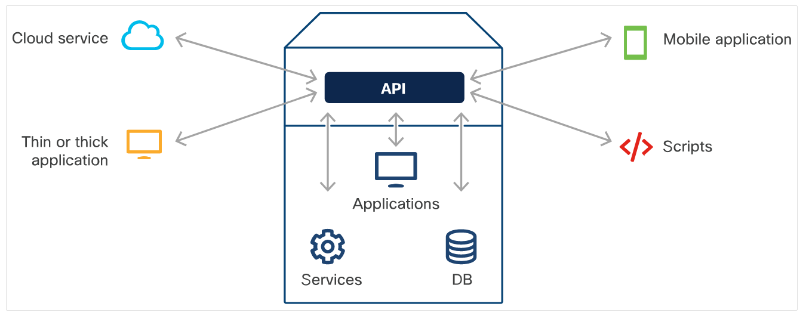
What is an API?
An API, or Application Programming Interface, acts as a communication bridge allowing different software to interact seamlessly.
It operates using common web-based protocols and might also have its unique, proprietary standards.
An API defines the type of data, services, and features an application shares with third parties.
By utilizing APIs, applications can maintain control and ensure secure exposure of their functionalities.
Different types of API integrations:

Slide 6
Why use APIs?
APIs are designed for programmatic consumption by applications, while also being accessible for manual interactions by users.
APIs Common Use Cases:
Automation Tasks: Leverage APIs to create scripts that automate repetitive, manual tasks seamlessly.
Data Integration: Facilitate applications to consume or respond to data shared by other applications, promoting interactivity.
Enhanced Functionality: Integrate the capabilities of another application to enhance product features and provide a richer user experience.

Slide 7
Why are APIs a Modern Essential?
APIs have been around for a long while, but their prominence and adoption have skyrocketed in recent years.
Driving Factors:
Intentional Design: Modern APIs are intricately integrated into products from the inception stage, ensuring robust functionality and security.
Testing: Contemporary APIs undergo extensive testing, ensuring reliability and consistent performance.
Accessibility through Simplified Languages: Languages like Python have democratized API consumption. They've bridged the gap, enabling not just developers but also professionals from other domains to harness the power of APIs in application building.

Slide 8
API Design Styles

Slide 9
Types of Design Styles
When building or consuming APIs, it's crucial to understand their design styles. The chosen design directly affects how an application communicates, processes data, and handles responses.
The way an application handles API responses varies based on the API's design.
Types of Design Styles
Synchronous
Asynchronous

Slide 10
Synchronous APIs
In synchronous APIs, the caller sends a request and waits for a response. The caller is blocked during this time and can't perform any other action until the response arrives or an error is thrown. Web-based APIs, such as REST, often follow this model.
Handling Responses: The consuming application typically waits for the response, blocking further operations. This might lead to system inefficiencies if not managed well.
When are APIs Synchronous?
APIs exhibit synchronous behavior when the requested data is instantly accessible.
Advantages of Synchronous API Design
A well-designed synchronous API allows applications to obtain data in real-time. This can lead to enhanced application performance if the API is optimally constructed.
Client-Side Processing
When using synchronous APIs, the requesting application has to pause and await the response prior to executing subsequent code.

Slide 11
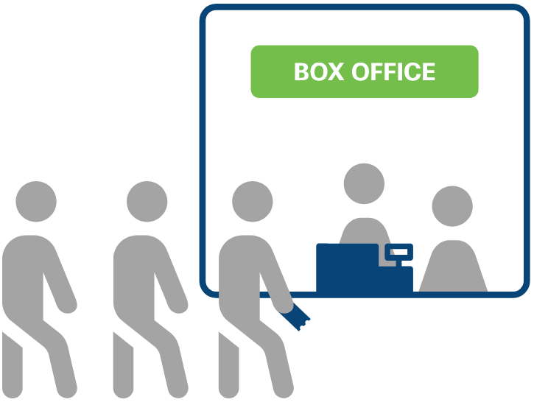
Synchronous APIs
Tickets are sold on a first-come, first-served basis. This process is synchronous.

Slide 12
Asynchronous APIs
Asynchronous APIs don't require the caller to wait for a response immediately. Instead, once a request is made, the caller can continue other tasks. The response or notification will be delivered once the processing is complete.
Handling Responses: The consuming application does not wait. Instead, it might use mechanisms like callbacks, events, or other notification systems to handle the eventual response.
When are APIs Asynchronous?
APIs tend to be asynchronous when processing a request takes some time on the server's side or when the requested data isn't immediately available.
Advantages of Asynchronous API Design
An optimally constructed asynchronous API enables applications to continue executing tasks without waiting for a response, resulting in improved overall performance and user experience.
Client-Side Processing
The client-side application doesn't wait for the server's response immediately after making a request. Instead, it continues with other tasks and handles the response when it arrives.

Slide 13
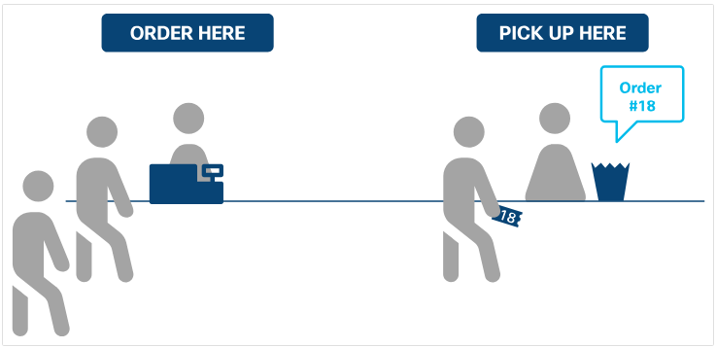
Asynchronous APIs
Tickets are sold on a first-come basis. However, after receiving a number, the caller can continue with other tasks. The response is only delivered when their number is announced. This method operates as an asynchronous process.

Slide 14
API Architectural Styles

Slide 15
Common Architectural Styles
Adopting established standards, protocols, and architectural styles helps streamline the learning and implementation process for API consumers.
Prominent API Architectural Styles:
RPC
SOAP
REST

Slide 16
Remote Procedure Call – RPC
Remote Procedure Call operates on a request-response paradigm, enabling an application to invoke a procedure in another address space, commonly on another computer on a shared network.
RPC can be executed over various transport protocols. Some popular implementations include:
XML-RPC: An RPC that utilizes XML to encode its calls and HTTP as a transport mechanism.
JSON-RPC: An RPC protocol encoded in JSON.
NFS: Allows a user on a client computer to access files over a network as if the network were a local hard disk.
SOAP: A messaging protocol that allows programs running on disparate operating systems to communicate using HTTP and its lower-layer protocols.

Slide 17
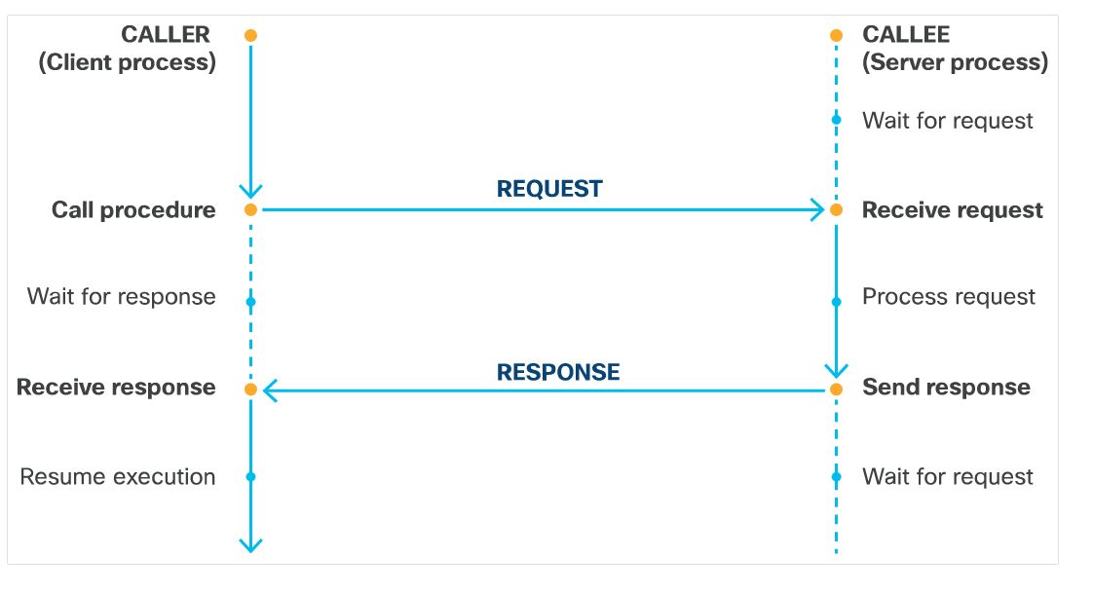
Remote Procedure Call – RPC
Workflow Illustrated:
The caller initiates a procedure call, effectively requesting a specific operation.
The callee (server-side) receives this request and processes the function.
Once processed, the server sends a response back to the caller.
The caller then proceeds with its operations post receiving the response.

Slide 18
Simple Object Access Protocol – SOAP
SOAP is a protocol that uses XML as its messaging format to connect and communicate between applications. It's designed for distributed computing environments and ensures that programs built on different platforms and programming languages can interoperate.
Characteristics of SOAP:
Independent: Enables communication between applications on diverse operating systems.
Extensible: Can easily incorporate additional features, such as reliability and security.
Neutral: Versatile in communication; can operate over various protocols like HTTP, SMTP, TCP, UDP, or JMS.
Components of a SOAP Message:
Envelope: The root element, encapsulating the entire XML document.
Header: Contains application-specific details, like authentication or other SOAP-related attributes.
Body: Holds the actual data intended for the recipient.
Fault: Supplies error or status information when issues arise.

Slide 19
SOAP Message Example
SOAP message example to configure an interface on a router:
<?xml version="1.0"?>
<soap:Envelope xmlns:soap="http://schemas.xmlsoap.org/soap/envelope/">
<soap:Header>
<authToken xmlns="http://example.com/routerConfig">ABCDE12345TOKEN</authToken>
</soap:Header>
<soap:Body>
<ConfigureInterface xmlns="http://example.com/routerConfig">
<InterfaceName>eth0</InterfaceName>
<IPAddress>192.168.1.10</IPAddress>
<SubnetMask>255.255.255.0</SubnetMask>
<Gateway>192.168.1.1</Gateway>
<Status>active</Status>
</ConfigureInterface>
</soap:Body>
</soap:Envelope>

Slide 20
REpresentational State Transfer – REST
REpresentational State Transfer is an architectural style authored by Roy Thomas Fielding.
Roy has established six constraints for REST:
Client-Server Architecture
Stateless Interactions
Cacheability
Layered System
Uniform Interface
Code-On-Demand (Optional)

Slide 21
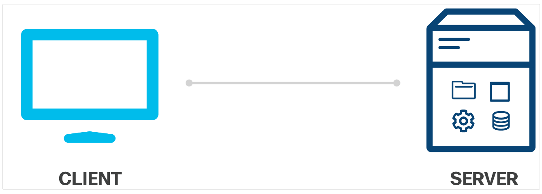
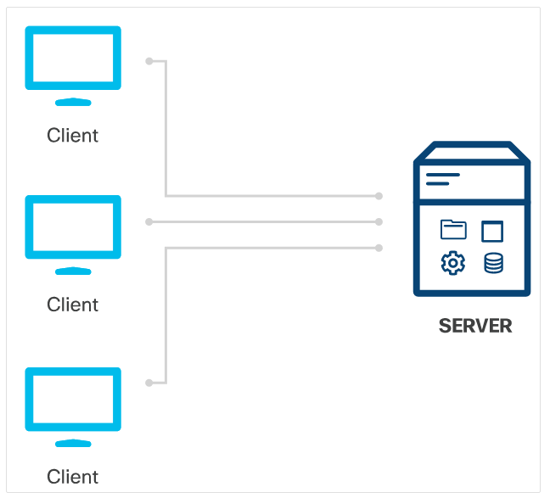
REpresentational State Transfer – REST
Client-Server
The principle is clear: the client and the server operate independently.
This separation allows the client side to be developed for different platforms.
On the server-side components become simpler and more streamlined.
Stateless
For every single request from a client to a server, the request must contain all the information needed for the server to fulfill that request.
The server should not store session state information between requests.

Slide 22
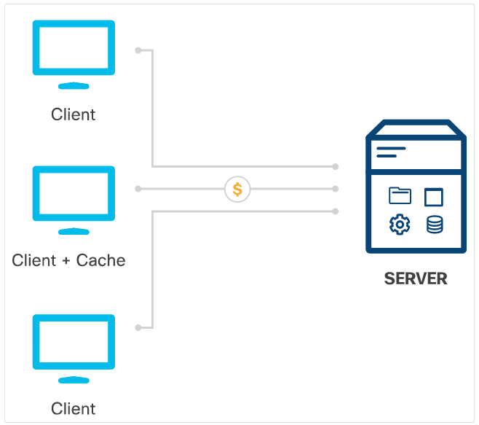
REpresentational State Transfer – REST
Cache Model:
Server responses should clearly indicate cacheability.
Cacheable responses allow clients to reuse data for future requests.
Uniform Interface:
Ensures consistent interactions between client and server.
Resource Identification: Clear and unique ways to identify resources.
Resource Manipulation: Resources are accessed and modified based on their representations.
Self-Descriptive Messages: Messages provide enough information about how to process them.
Hypermedia: Drives application state forward, linking related resources together.

Slide 23
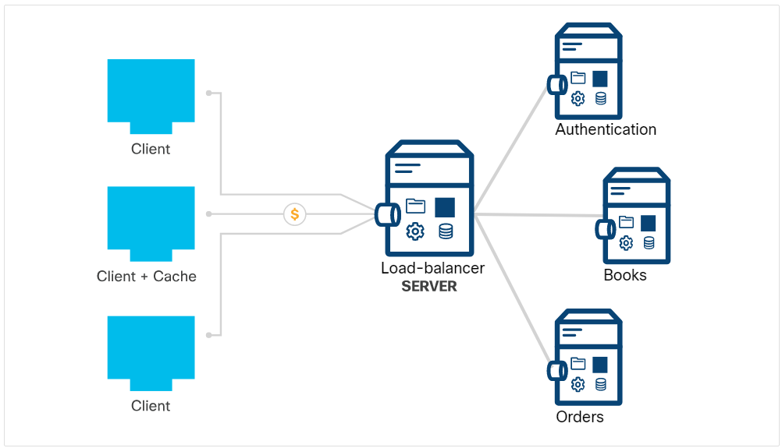
REpresentational State Transfer – REST
Layered System:
Consists of hierarchical layers where each layer serves the one above and is served by the one below.
Provides modularity, allowing independent evolution of components.
Code-on-Demand:
RESTful services can return not just data but also executable code (e.g., JavaScript).
Enables extending client functionality dynamically.
This constraint is optional due to potential security concerns of executing third-party code.

Slide 24
Introduction to REST APIs

Slide 25
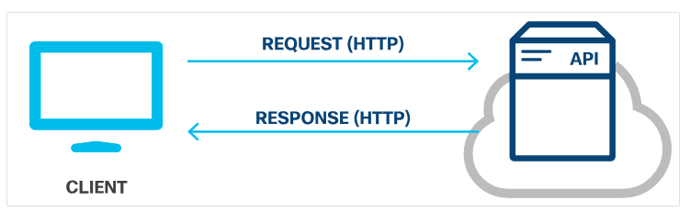
REST Web Service APIs
A REST API or RESTful API is a programming interface built upon the architectural principles of REST and It communicates over the HTTP protocol.
REST APIs leverage foundational HTTP concepts to ensure standardization and simplicity:
Requests and Responses
Verbs: Methods like GET, POST, PUT, and DELETE.
Status Codes: Indicators such as 200 OK for successful operations, 404 Not Found for missing resources, and more.
Headers and Body: Metadata in headers guide the handling of content, while the body carries the main data payload.

Slide 26
REST API Requests
REST API requests act as a bridge for an application or client to instruct the server to execute a specific function. These requests comprise four crucial elements:
Uniform Resource Identifier (URI): The unique identifier to locate resources on the server.
HTTP Method: Specifies the desired action (e.g., GET, POST, PUT, DELETE) to be performed on the resource.
Header: Contains meta-information about the request, like authentication tokens, content type, etc.
Body: Houses the main content or data payload of the request, especially relevant for POST or PUT methods.

Slide 27
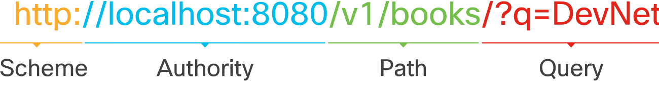
REST API Requests – URI
The URI (Uniform Resource Identifier), often referred to as a URL (Uniform Resource Locator), distinctly pinpoints the resource a client aims to interact with. A URI consists of several components:
Scheme: Determines the HTTP protocol in use, whether it's http or https.
Authority: Comprised of the host where the resource resides and the port or the communication endpoint.
Path: Designates the exact location or endpoint of the resource on the server.
Query: Offers further specifics, often for refining a request, filtering results, or providing additional context.
Visual Breakdown of URI Components

Slide 28
REST API Requests – HTTP Methods
HTTP methods in RESTful APIs define the type of operation the API intends to perform. They follow the standard conventions of the HTTP protocol, ensuring clarity and simplicity in communication.
By adhering to these conventions, REST APIs maintain consistency and simplicity, ensuring easy interoperability and understanding for developers.
HTTP Method | Action | Description
POST | Create | Create a new object or resource.
GET | Read | Retrieve resource details from the system.
PUT | Update | Replace or update an existing resource.
PATCH | Partial Update | Update some details of an existing resource.
DELETE | Delete | Remove a resource from the system.

Slide 29
REST API Requests – Header
HTTP headers offer a standardized way to provide additional meta-information in an HTTP request. They are presented as name-value pairs and play a vital role in RESTful communication. They are separated by a colon. ([name]:[value])
Types of HTTP Headers:
Request Headers: These contain metadata not directly related to the content of the message, like authentication or information about the client.
Entity Headers: Describe the body's content, including its length or type.
Key | Value | Example Value
Authorization | Basic dmFncmFudDp2YWdyYW | Provide credentials to authorize the request.
Key | Value | Example Value
Content-Type | application/json | Specify the format of the data in the body.

Slide 30
REST API Requests – Body
The body holds the central content of the REST API request. It provides specific data or information about the resource the client aims to interact with.
Certain HTTP methods, such as POST, PUT, and PATCH, frequently have an accompanying body.
The inclusion of a body depends on the particular HTTP method being used. Not all requests necessitate a body.
If there's data in the body, its format or type needs to be indicated in the headers. This is achieved using the Content-Type key.

Slide 31
REST API Response
REST API responses serve as how servers convey the outcomes of a client's request. These responses adhere to the structure and conventions of the HTTP protocol.
HTTP Status: This indicates the result of the client's request. Status codes, like 200 (OK) or 404 (Not Found), provide a brief overview of whether the request was successful or encountered an issue.
Header: Just like in the request, the response header provides metadata about the response. It might contain information on the type of data returned, any set cookies, or server details.
Body: The main content of the response, this section holds the requested data or a descriptive error message, depending on the request's outcome.

Slide 32
REST API Response – Http Status Code
HTTP status codes provide immediate feedback about the result of an HTTP request. Their role is essential in guiding the client on how to interpret the response and potentially how to proceed.
All HTTP status codes are composed of three digits. The first digit classifies the type of response, while the subsequent two digits are incremental numbers within that category.
1xx – Informational: These codes relay that the request was received and understood. Typically, they don't carry a body as they're just for information.
2xx – Success: A testament to a successful request. The server understood, accepted, and processed the request.
3xx – Redirection: Indicates that further steps are needed to finalize the request, like following a redirect.
4xx – Client Error: These codes signal issues with the request from the client's side. It could be due to incorrect syntax, unauthorized requests, or unfulfillable demands.
5xx – Server Error: Even if the client's request was valid, sometimes the server can't complete it. These codes inform the client of internal server issues.

Slide 33
REST API Response – Header
Same as request headers, offer a standardized way to provide additional meta-information in an HTTP response.
Types of HTTP Headers:
Request Headers:
Entity Headers: Describe the body's content, including its length or type.
Key | Value | Example Value
Set-Cookie | JSESSIONID=30A9DN810FQ428P; Path=/ | Used to send cookies from the server.
Cache-Control | Cache-Control: max-age=3600, public | Specify directives which must be obeyed by all caching mechanisms
Key | Value | Example Value
Content-Type | application/json | Specify the format of the data in the body.

Slide 34
REST API Response – Body
The body of a REST API response contains the actual data that the server returns in response to a client's request.
Response Pagination:
Enables data to be broken into chunks.
Most APIs that implement pagination use the query parameter to specify which page to return in the response.
Compressed Response Data:
Reduces large amounts of data that cannot be paginated.
To request data compression, add the Accept-Encoding field to the request header. Accepted values include:
gzip
compress
br
* (Indicates any encoding method is acceptable)

Slide 35
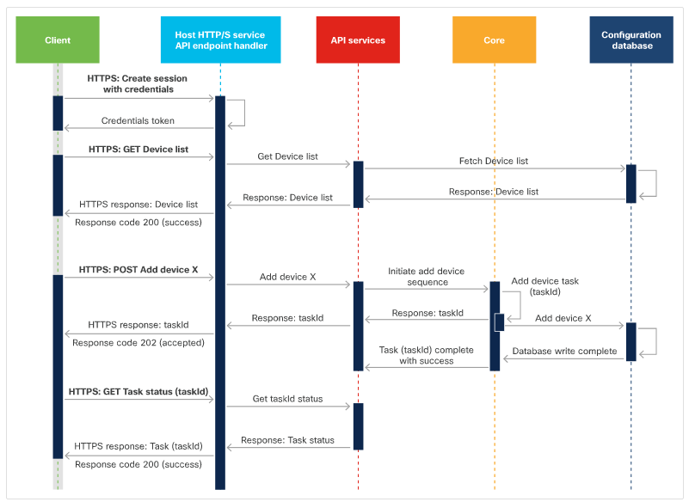
Using Sequence Diagrams with REST API
Sequence diagrams visually represent the flow of operations, demonstrating the interactions between different components.
They are especially beneficial for clarifying complex processes like those in REST APIs.
Three API Request Sequence Exemaple:
Create Session: Initiates a connection by sending credentials.
Get Devices: A series of requests and responses to retrieve device information.
Create Device: Initiates a POST request to incorporate a new device.

Slide 36
Authenticating to a REST API

Slide 37


REST API Security
To safeguard data integrity, REST APIs requires authentication and authorization mechanisms, preventing unauthorized users from accessing or modifying information.
But some APIs, primarily read-only ones, may not mandate authentication, ensuring they don't hold sensitive or confidential data.
Authentication: Ensures only valid users can access the API.
Authorization: Determines what actions or resources the authenticated user can access.

Slide 38
REST API Authentication
Ensuring secure access to REST APIs necessitates a robust authentication method. Here are some prevalent methods of authentication mechanisms in APIs
Basic Authentication:
Direct transmission of credentials.
Credentials consist of a username/password, separated by a colon (:).
They are encoded using Base64.
Bearer Authentication:
Utilizes a bearer token.
This token is a unique string, usually generated by an authentication server, like an Identity Service.
API Key:
A unique alphanumeric identifier issued to users.
There are two main varieties: public and private keys, which have different uses and levels of security.

Slide 39
Authorization Mechanisms: OAuth
While there are numerous authorization mechanisms, OAuth stands out as one of the most widely adopted methods, especially in the context of modern web services.
Purpose: OAuth was birthed as a response to previous insecure authentication mechanisms, offering a robust solution. OAuth integrates both authentication and authorization.
Enhanced Security: OAuth offers superior security measures, establishing it as a preferred choice for developers worldwide.
Versions & Compatibility: There are two main versions of OAuth - OAuth 1.0 and OAuth 2.0. However, OAuth 2.0 is not backward compatible with its predecessor.
Functionality: OAuth 2.0 allows third-party applications to gain limited access to an HTTP service without exposing the user's password. The authorization framework facilitates this through an access token mechanism.
User Interaction: OAuth lies in its user-centric design. Users provide credentials directly to a trusted authorization server. Once authenticated, they receive an access token, which they then present to the requesting application.
The Flow: This term commonly refers to the journey from credential presentation to token acquisition.

Slide 40
API Rate Limits

Slide 41
What are Rate Limits?
An API rate limit is a mechanism allowing web services to regulate the number of requests an individual or an application can initiate within a specified time frame.
Benefits of Rate Limiting:
Server Protection: Prevents server overloads by mitigating excessive requests.
Enhanced Service: Guarantees improved service and response times for all users.
Security: Acts as a defense against potential Denial-of-Service (DoS) attacks.
Rate Limit Algorithms: Different algorithms offer various ways to implement rate limiting based on specific needs. Some examples are:
Token Bucket
Leaky Bucket
Fixed Window
Sliding Window

Slide 42
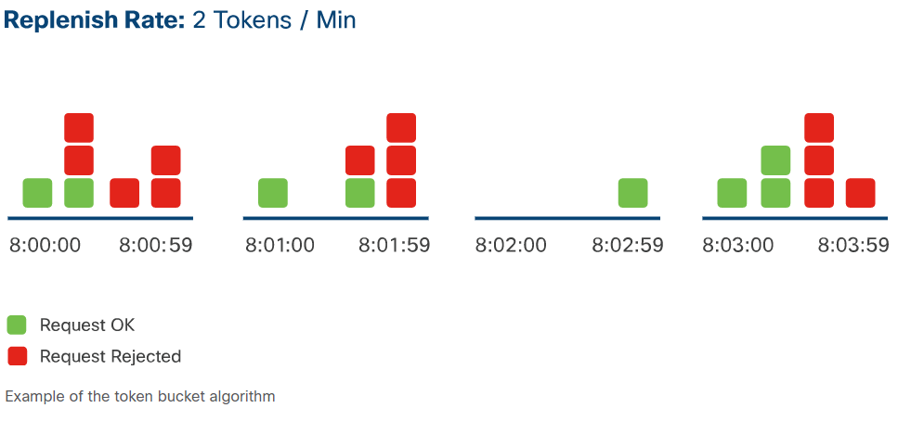
Token Bucket Algorithm
The Token Bucket Algorithm allots a specific number of tokens to each user over a defined time interval.
Upon receiving a request, the server inspects the bucket to determine the availability of a token.
If a token is present, it's consumed, and the request is processed. If no tokens remain, the server denies the request.
To prevent request rejections, the client should keep track of their token count
A number of tokens are incremented over time, and one token is removed per request.

Slide 43
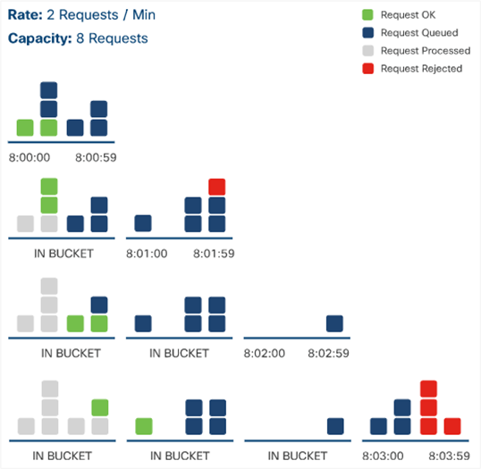
Leaky Bucket Algorithm
The Leaky Bucket Algorithm processes incoming requests in the order they're received, placing them in a request queue.
Requests can come at any rate, but they are processed at a consistent fixed rate.
When the request queue is full, any new requests are rejected. This phenomenon is also known as 'leaking’.
"Water flows into the bucket at a variable rate, but drips out consistently at a predetermined rate."

Slide 44
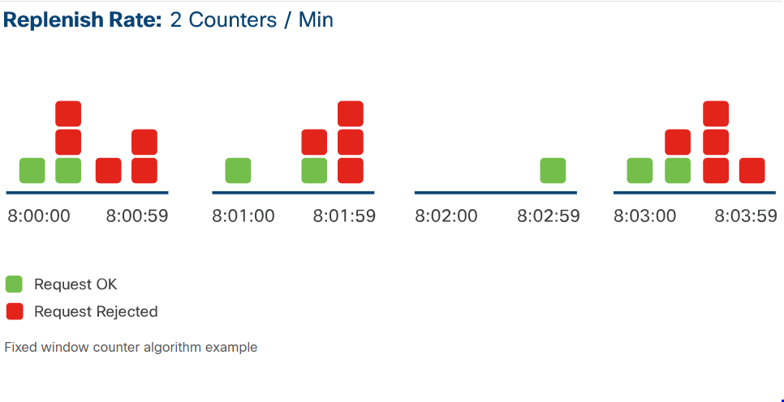
Fixed Window Counter Algorithm
The Fixed Window Counter Algorithm divides time into fixed intervals, each with an assigned limit of requests that can be processed.
Upon receiving a request, the server checks the counter for the current time window.
If the counter is not yet at its limit, the request is processed, and the counter is incremented.
If the limit for that time window has been reached, subsequent requests within that window are rejected.

Slide 45
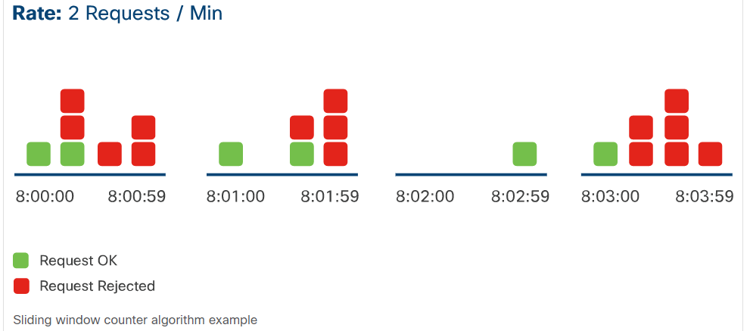
Sliding Window Counter Algorithm
The Sliding Window Counter Algorithm permits a specified number of requests within a defined time frame.
Upon receiving a new request, the server counts the number of requests made from the start of the window up to the present moment.
Based on this count, it then decides whether to process or decline the request.
Clients should be cautious, ensuring they don't surpass the rate limit at the time of their request.

Slide 46
Understanding the Rate Limit
Many APIs employing rate limiting furnish specifics about the imposed limit within the response headers.
The most prevalent Rate Limit headers are:
X-RateLimit-Limit: The highest count of requests permissible within a predetermined time.
X-RateLimit-Remaining: The number of requests that can still be issued within the ongoing rate limit window.
X-RateLimit-Reset: The precise time at which the rate limit window will reset.
When an API's rate limit has been exceeded, the server will reject any subsequent requests, returning an HTTP response to the client.
This HTTP response also communicates the exceeding using a specific HTTP status code. The prevalent status codes for such scenarios include:
429: Too Many Requests
403: Forbidden

Slide 47
Working with Webhooks

Slide 48
What is a Webhook?
A Webhook is an automated method for one system to provide real-time data to another upon the occurrence of specific events. It's essentially a way for applications to communicate between each other automatically.
Key Points:
Acts as an HTTP callback: When certain events occur, the source site makes an HTTP POST to a specified URL.
Efficiency: Eliminates the need for repetitive polling; data is sent as events occur.
Also known as reverse APIs.
Multiple applications can subscribe to a single webhook, allowing data dissemination.
Real-World Examples:
The Cisco DNA Center platform uses webhooks to inform third-party applications about network events in real-time.
With Cisco Webex Teams, you can set up a webhook to get notifications for new messages in a designated room.

Slide 49
Consuming a Webhook
To effectively receive notifications from a webhook provider, an application needs to fulfill specific prerequisites:
It should be continuously operational to accept incoming HTTP POST requests.
A URI specific to the application must be registered with the webhook provider.
It's imperative for the application to process and manage the notifications it receives from the webhook server.
To validate the reception of notifications from a webhook, consider using free online tools available.

Slide 50
Troubleshooting API Calls

Slide 51
Addressing REST API Request Issues
At times, your API request might not yield the expected response. Gaining proficiency in pinpointing and rectifying prevalent REST API challenges becomes crucial in such scenarios.
There will be times when API servers are unreachable or fail to respond. Error messages resulting from these requests can help on the problem's origin.
For effective troubleshooting:
Ensure you have the API reference guide accessible.
Keep your API authentication details at the ready.

Slide 52
No Response and HTTP Status Code
Client-Side Error Troubleshooting Tips:
User Error: Mistakes like incorrectly typing the URI or using wrong authentication methods, especially when accessing the API for the first time.
Invalid URI: Situations arising from a mistyped or incorrect URI. For example:
import requests
uri = "sandboxdnac.cisco.com/dna/intent/api/v1/network-device“ < HTTPS Forgotten
resp = requests.get(uri)
Wrong Domain Name: Errors resulting from using a mistyped or incorrect domain name. For example:
import requests
url = "https://sandboxdnac123.cisco.com/dna/intent/api/v1/network-device"
resp = requests.get(url)

Slide 53
No Response and HTTP Status Code
Client-Side Error Troubleshooting Tips:
Connectivity Issues
Could there be issues with Proxies, Firewalls, or VPNs?
Are you encountering any SSL errors?
Invalid Certificate: When using a secure connection (HTTPS) for a REST API URI, the client and server perform an SSL handshake. If this fails, the certificates need to be fixed.
...requests.exceptions.SSLError: HTTPSConnectionPool(host='https://sandboxdnac.cisco.com/', port=443):
Max retries exceeded with url: /dna/intent/api/v1/network-device
(Caused by SSLError(SSLCertVerificationError(1, '[SSL: CERTIFICATE_VERIFY_FAILED]
certificate verify failed: self-signed certificate (_ssl.c:1108)')))
In lab environments or during development, you may encounter invalid certificates. To continue development, you can bypass the SSL certificate verification.
Use the verify parameter in the Python requests library to disable certificate verification:
resp = requests.get(url, verify=False)

Slide 54
No Response and HTTP Status Code
Server-Side Error Troubleshooting Tips:
API Server Functionality: Ensure the API server is operational. Factors such as power outages, cabling issues, or domain name changes can affect its functioning.
To determine if the IP address is reachable, execute a script that sends a request to the API server and awaits a response.
A prolonged delay or absence of a response can indicate that the API server isn't operational.
Communication Issues: Use network capturing tools to monitor data transfer between the API server and the client to check communication issues.
If you have access on API server, inspect the API server logs to verify if the request was received.
Common Resolution:
Problems originating server-side typically cannot be addressed from the client side.
Reach out to the API server's administrator to resolve the issues.

Slide 55
Interpreting Status Codes
HTTP status codes are an integral part of the HTTP standard. The first digit indicates the code's category, while the subsequent two merely specify the exact status.
Here's a quick breakdown of the categories:
1xx - Informational: Request received; processing is ongoing.
2xx - Success: The request was successful; understood and accepted.
3xx - Redirection: Additional steps required to complete the request.
4xx - Client Error: The request has bad syntax or can't be processed.
5xx - Server Error: The server couldn't process an otherwise valid request.
Steps for Effective Troubleshooting:
Analyze the Return Code: During development, display the return code in your script.
Inspect the Response Body: Showcase the response body during development.
Refer to the Status Code Definitions: Especially useful when neither the return code nor the response body elucidates the issue.

Slide 56
2XX and 4XX Status Codes
This codes indicate successful server interactions and client errors due to improper requests.
2xx: Represents successful interactions between the client and server.
4xx: Indicates errors originating from the client side.
Breaking down some common 4xx errors:
400 - Bad Request: The server can't understand the request due to incorrect syntax. Typical issues include incorrect resource naming or JSON/XML object syntax errors.
401 - Unauthorized: The server can't authenticate the request. Verify your credentials: username, password, API key, token, request URI.
403 - Forbidden: The server acknowledges the authentication, but the client lacks authorization.
407 - Proxy Authentication Required: This resembles the 401 error but demands that the client authenticate with the proxy.
409 - Conflict: The request clashes with the server's current resource state. The server may process the request if retried post resolving the conflict.
415 - Unsupported Media Type: The client sends data in an unsupported format.
For example, sending XML to a JSON-only server would yield a 415 error.

Slide 57
5XX Status Codes
5xx codes indicate server errors, signaling that the server failed to fulfill a valid request.
Breaking down some common 5xx errors:
500 - Internal Server Error: The server encountered an unexpected condition that prevented it from fulfilling the request.
501 - Not Implemented: The server does not support the functionality required to fulfill this request.
502 - Bad Gateway: The server acting as gateway or proxy received an invalid response from an inbound server.
503 - Service Unavailable: The server is currently unable to handle the request due to overload or scheduled maintenance.
504 - Gateway Timeout: The server did not receive a timely response from an upstream server.

Slide 58

Obrigado!

